Slide 1
RA 505 Robot Sensing and Vision Lecture 37
Dr. Rishikesh Kulkarni
Department of Electronics and Electrical Engineering
IIT Guwahati

Slide 2
Sensor signal conditioning
Amplification
Analog to digital and digital to analog conversion
Filtering
Display
Transmission
Data Interpretation

Slide 3
Analog-to-Digital and Digital-to-Analog Converter
Very important in sensor data processing
A/D: translating analog signals to equivalent binary signals
D/A: translating digital information into equivalent analog information
A/D converters are used to convert analog signal generated by transducers into digital form to feed them into microprocessor system. A/D is referred to as an encoding device.
D/A converters can be used to drive actuators according to the control output generated by microprocessors. Thus, D/A can also be considered as a decoding device. A D/A converter is usually an integral part of any A/D conversion.

Slide 4
Digital-to-Analog Converter
Variable resistor network As per Millman’s theorem
1. Each resistance in the network has a different value. Since the dividers are usually constructed
using precision resistor, their cost factor increases.
2. The resistance used in the MSB is required to handle a much higher current than the LSB
resistor.

Slide 5
Digital-to-Analog Converter: R-2R laddar
R-2R laddar

Slide 6
Digital-to-Analog Converter

Slide 7
Digital-to-Analog Converter
Errors in DAC
Non-linearity
Non-monotonicity
non-linearity error is quantified as differential non-linearity error (DNL)
Dynamic range

Slide 8
Analog-to-Digital Convertor
Analog-to-digital converter as the name suggests, converts the analog signal into equivalent digital signal.
It is usually referred as A/D, A-D or ADC. For a n-bit A/D, there are 2^{n} distinct digital levels one of which represents the analog signal.
We will discuss different A/D techniques in the following.

Slide 9
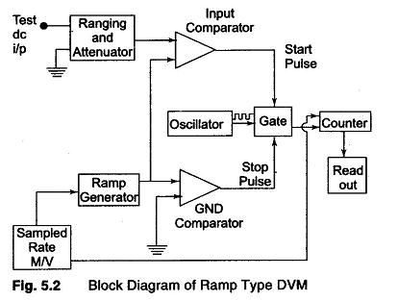
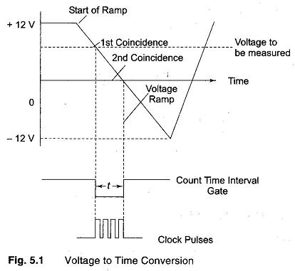
Analog-to-Digital Convertor: Ramp technique
+- 0.005% accuracy

Slide 10
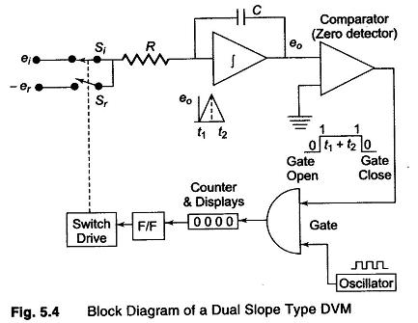
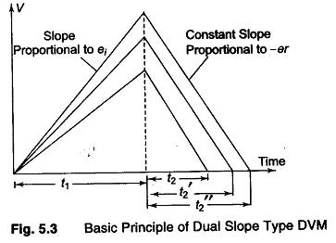
Analog-to-Digital Convertor: Dual-slope
Excellent noise rejection; +- 0.05% accuracy in 100 ms.

Slide 11
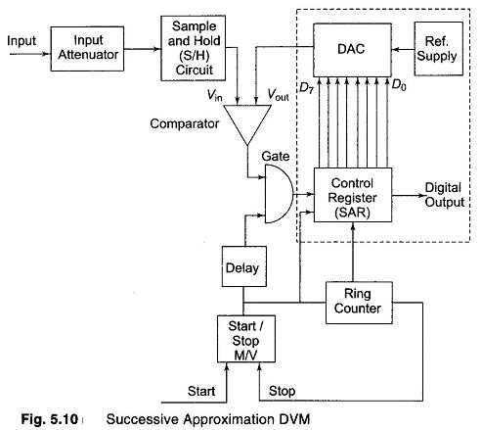
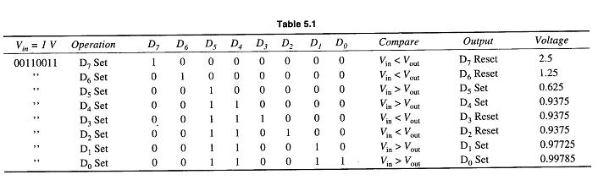
ADC: Successive Approximation

Slide 12
A/D Signal-to-noise ratio
The quantization process in the A/D converter produces noise in the converted signal.
The quantification of it is done in terms of signal-to-noise ratio (SNR) of A/D converter.
SNR = 6.02N + 1.76 dB (N-bit ADC)
https://www.analog.com/media/en/training-seminars/tutorials/MT-001.pdf

Slide 13
Bridge Circuits
Ubiquity of resistive sensors
Displacement
Pressure
Temperature
Humidity
Force
Flow
Bridge configurations
Non-linearity
Bridge sensitivity

Slide 14
Bridge Circuits

